Slide 1
Chapter 8
Network Layer – Part 4
(VLSM)

Slide 2

Objectives
Perform VLSM calculation (Class A, B, C)

Slide 3
Introduction
Variable-Length Subnet Masking (VLSM) is a subnetting method that allows network engineers to divide IP networks into subnetworks of different sizes → different hosts count in each subnet and thus reduce wastage in assigning IP addresses.

Slide 4
Comparisons on FLSM and VLSM
FLSM | VLSM
Traditional subnetting (Fixed-Length Subnet Masking) creates subnets of all the SAME size | VLSM creates subnets of DIFFERENT sizes
Each subnet has equal number of hosts | Each subnet may have different number hosts depends on the requirements
Subnets are created base on no. of subnets required * | Subnets are created based on no. of hosts required
FLSM causes wastage in the IP addresses as not every subnet requires equal no. of IP addresses | VLSM reduces wastage in IP addresses as it allows a big subnet to be divided into smaller sub-subnets depending on the needs.
Aka Classful Addressing | Aka Classless Addressing
Supported by RIPv1 | Supported by RIPv2, OSPF, EIGRP, Dual IS-IS, and BGP

Slide 5
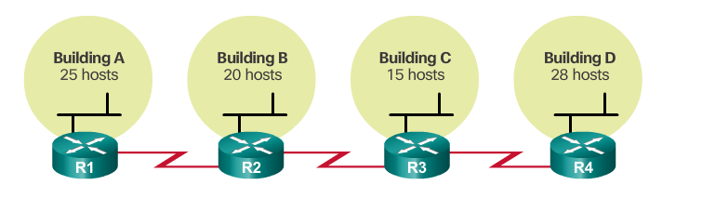
Traditional Subnetting
2 IPs needed
2 IPs needed
2 IPs needed

Slide 6
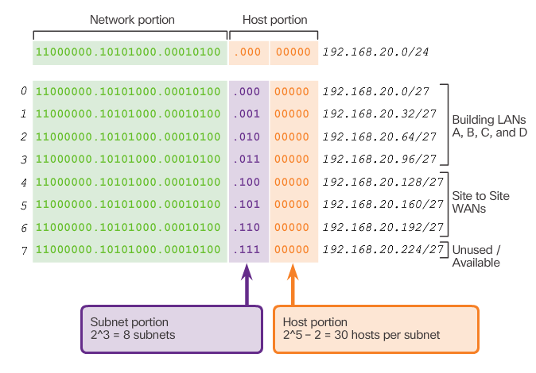
Traditional Subnetting
7 subnets needed

Slide 7
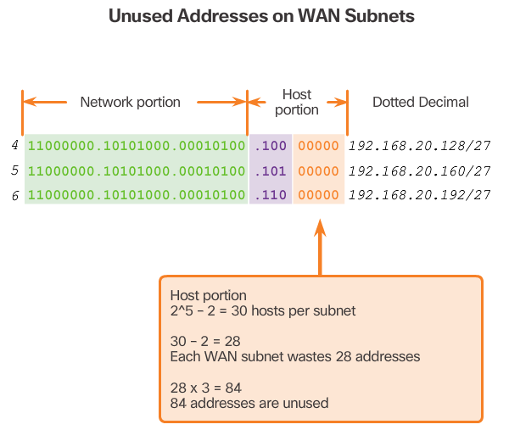
FLSM causes wastage in the IP addresses as not every subnet requires equal no. of IP addresses

Slide 8
Methods to perform VLSM
Box Method
Circle Method
Chart Method
* the subnetting assignment will start from the largest subnet to the smallest subnet

Slide 9
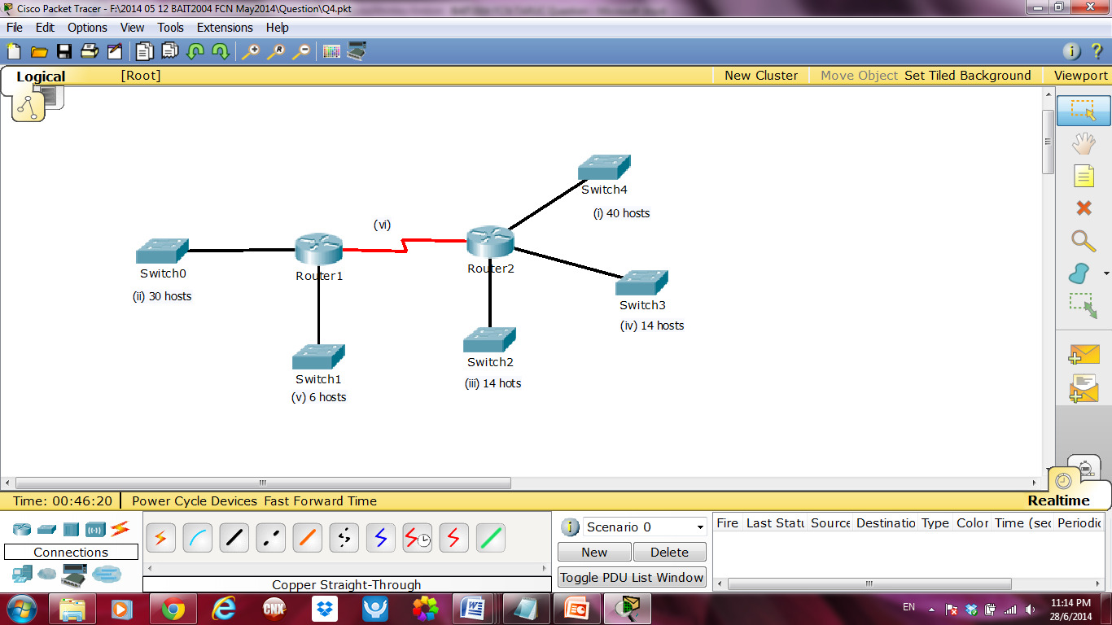
Exercise 1 (Past Year Questions)
193.3.6.0/24

Slide 10
Create an addressing scheme which utilizes variable-length subnet masks (VLSM).
Show the network address, broadcast address, first usable address and last usable address for each subnet (i) – (vi)

Slide 11
VLSM Calculation
Arrange the network from the largest to the smallest
Subnet | Network Address | First Usable Address | Last Usable Address | Broadcast Address
(i) – 40
(ii) – 30
(iii) – 14
(iv) – 14
(v) – 6
(vi) – 2

Slide 12
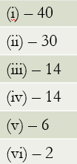
Box Method
0
192.3.6.128 /29
136
192.3.6.0 /26
128
192.3.6.136 /30
160
139
140
135
143
144
63
159
191
192.3.6.64 /27
192.3.6.96 /28
64
96
192
111
192.3.6.112 /28
112
95
127
255

Slide 13
Subnet | Network Address | First Usable Address | Last Usable Address | Broadcast Address
(i) – 40 | 192.3.6.0 /26 | .1 | .62 | 192.3.6.63 /26
(ii) – 30 | 192.3.6.64 /27 | .65 | .94 | 192.3.6.95 /27
(iii) – 14 | 192.3.6.96 /28 | .97 | .110 | 192.3.6.111 /28
(iv) – 14 | 192.3.6.112 /28 | .113 | .126 | 192.3.6.127 /28
(v) – 6 | 192.3.6.128 /29 | .129 | .134 | 192.3.6.135 /29
(vi) – 2 | 192.3.6.136 /30 | .137 | .138 | 192.3.6.139 /30

Slide 14
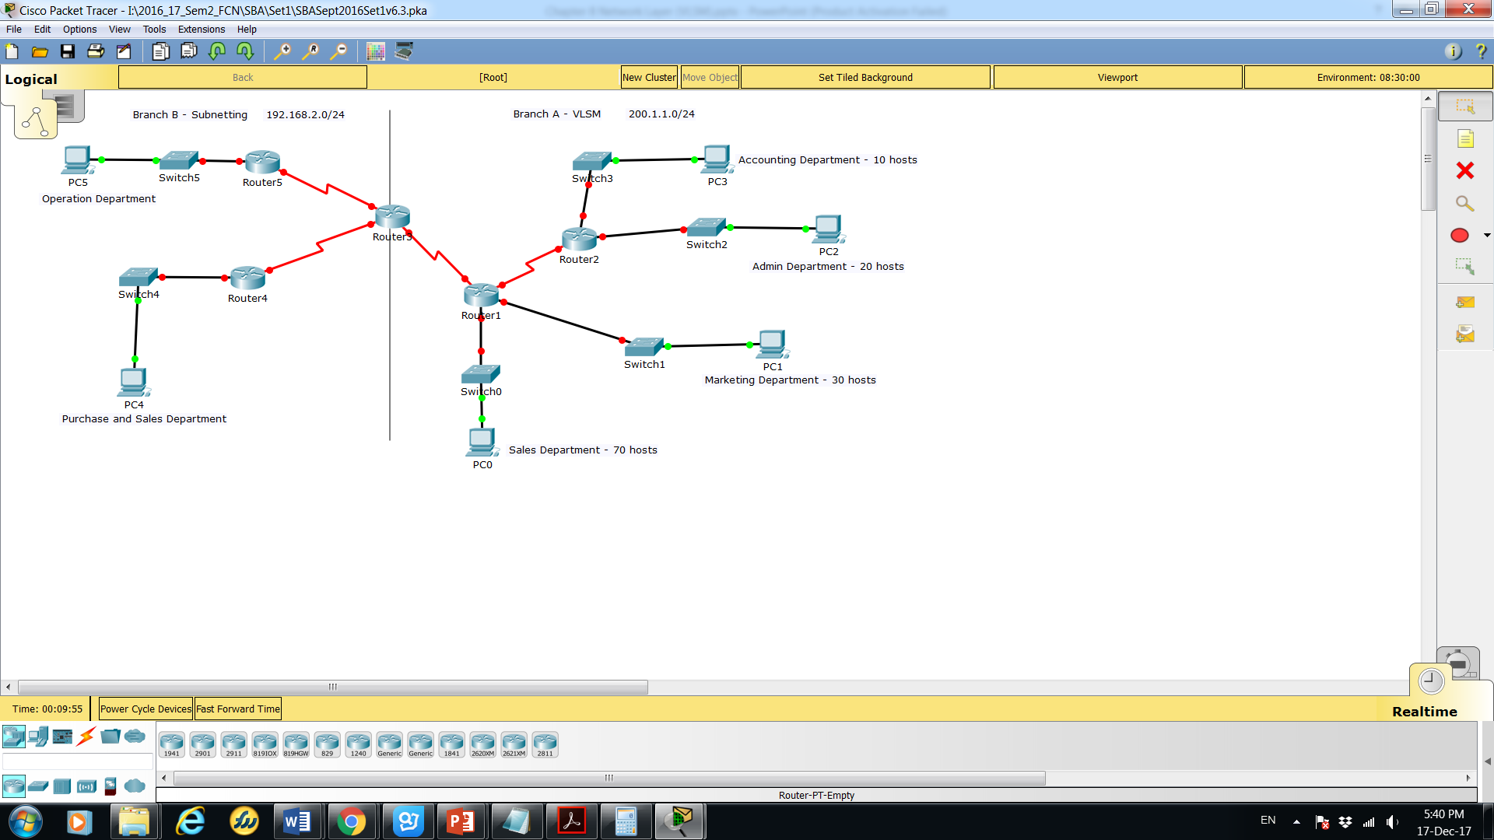
Exercises 2 (Past Year SBA)

Slide 15
Branch A - VLSM
Subnet Description | Number of Hosts Needed | Subnet Address/CIDR | First Usable Host Address | Last Usable Host Address | Broadcast Address

Slide 16
Branch A - VLSM
200.1.1.0 /24
Subnet Description | No of Hosts Needed | Subnet Address/CIDR | First Usable Host Address | Last Usable Host Address | Broadcast Address
Sales Dpt | 70 | 200.1.1.0 /25 | .1 | .126 | 200.1.1.127 /25
Marketing Dpt | 30 | 200.1.1.128 /27 | .129 | .162 | 200.1.1.159 /27
Admin Dpt | 20 | 200.1.1.160 /27 | .165 | .190 | 200.1.1.191 /27
Accounting Dpt | 10 | 200.1.1.192 /28 | .193 | .206 | 200.1.1.207 /28
R1 – R2 | 2 | 200.1.1.208 /30 | .209 | .210 | 200.1.1.211 /30
R1 – R3 | 2 | 200.1.1.212 /30 | .213 | .214 | 200.1.1.215 /30

Slide 17
Branch B - Subnetting
Subnet Number | Subnet Address | First Usable Host IP | Last Usable Host IP | Broadcast Address
0
1
2
3

Slide 18
Branch B - Subnetting
192.168.2.0 /24
Subnet Number | Subnet Address | First Usable Host IP | Last Usable Host IP | Broadcast Address
0 | 192.168.2.0 /26 | .1 | .62 | 192.168.2.63 /26
1 | 192.168.2.64 /26 | .65 | .126 | 192.168.2.127 /26
2 | 192.168.2.128 /26 | .129 | .190 | 192.168.2.191 /26
3 | 192.168.2.192 /26 | .193 | .254 | 192.168.2.255 /26

Slide 19
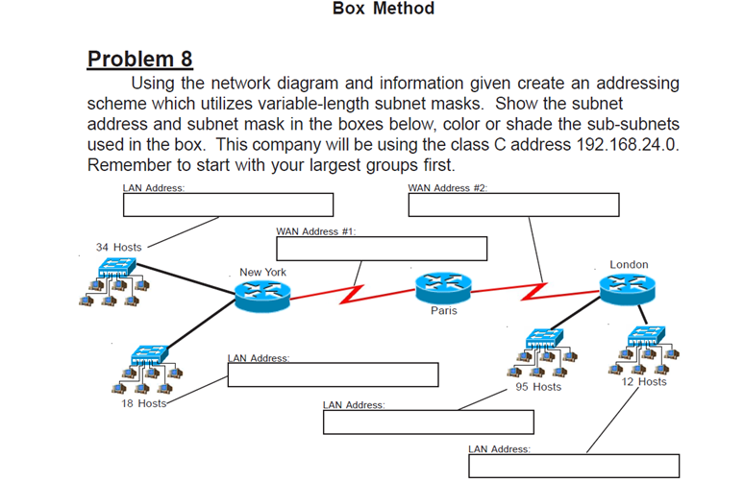
Exercises 3 (VLSM Workbook)

Slide 20
VLSM Calculation
Subnet Description | No of Hosts Needed | Subnet Address/CIDR
N0 (LAN1) | 95 (97) | 192.168.24.0 /25
N1 (LAN2) | 34 (36) | 192.168.24.128 /26
N2 (LAN3) | 18 (20) | 192.168.24.192 /27
N3 (LAN4) | 12 (14) | 192.168.24.224 /28
N4 (WAN1) | 2 (4) | 192.168.24.240 /30
N5 (WAN2) | 2 (4) | 192.168.24.244 /30

Slide 21
192.168.24.128 /26
192.168.24.244 /30
192.168.24.240 /30
192.168.24.192 /27
192.168.24.0 /25
192.168.24.224 /28

Slide 22
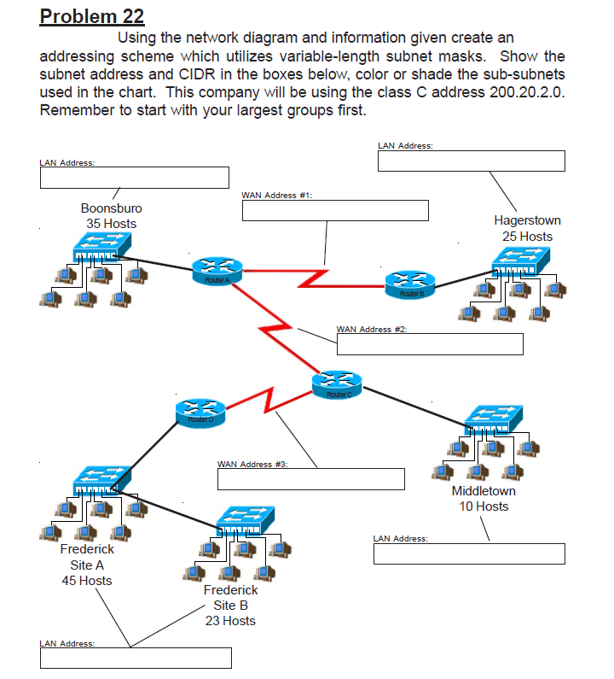
Exercises 4 (VLSM Workbook)

Slide 23
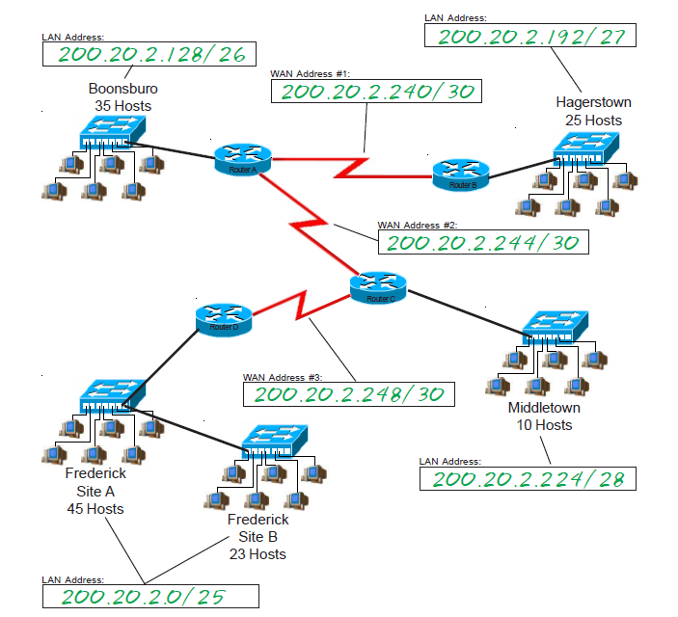

Slide 24
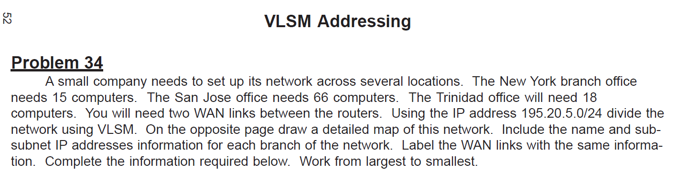
Exercises 5 (VLSM Workbook)

Slide 25
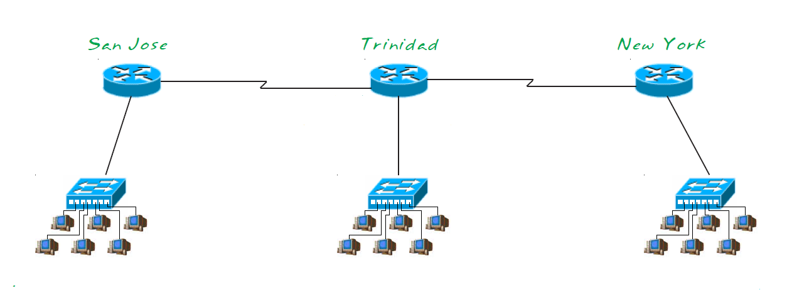
2
2
15
66
18

Slide 26
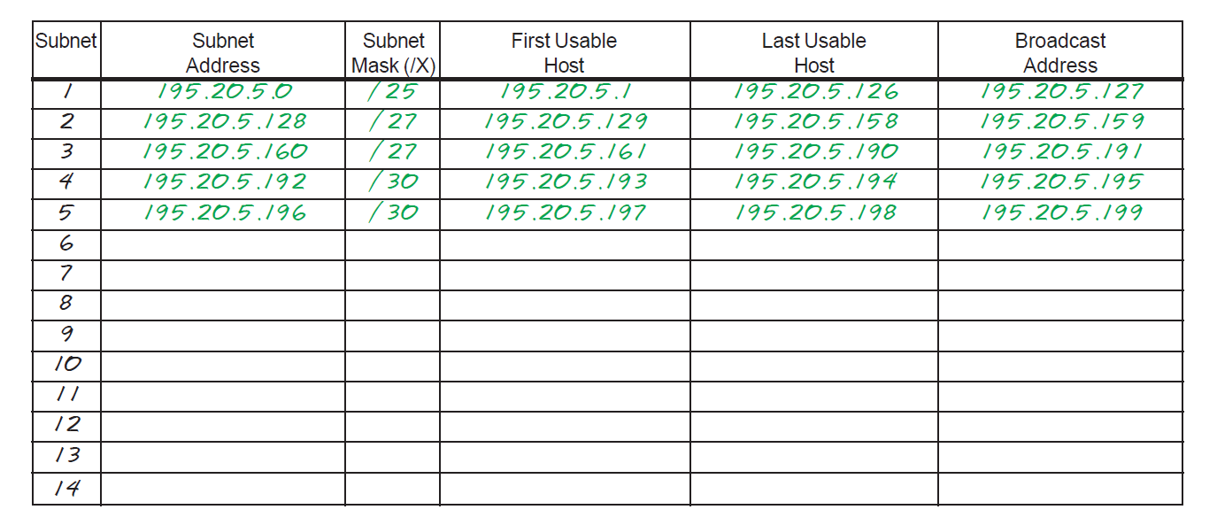

Slide 27
Exercises 6 (online resources)
Given the network address 204.15.15.0 /24 and requirements as the example above, develop a subnetting scheme using VLSM, given:
Net A: must support 14 hosts
Net B: must support 28 hosts
Net C: must support 2 hosts
Net D: must support 7 hosts
Net E: must support 28 host

Slide 28
VLSM Calculation
Subnet Description | No of Hosts Needed | Subnet Address/CIDR | Host Address Range
Net B | 28 | 204.15.15.0 /27 | 1 – 30
Net E | 28 | 204.15.15.32 /27 | 33 – 62
Net A | 14 | 204.15.15.64 /28 | 65 – 78
Net D | 7 | 204.15.15.80 /28 | 81 – 94
Net C | 2 | 204.15.15.96 /30 | 97 - 98

Slide 29
Exercise 7 (Tutorial Question)
Given a network 172.32.0.0/16. Perform VLSM to fulfil the following subnetting requirements
Customer Name | Number of Assresses | Address Range | CIDR
North High | 2400 | 172.32.0.0 - 172.32.15.255 | /20
South High | 2000 | 172.32.16.0 - 172.32.23.255 | /21
North Middle | 1200 | 172.32.24.0 - 172.32.31.255 | /21
South Middle | 1000 | 172.32.32.0 - 172.32.35.255 | /22
Central Elem | 550 | 172.32.36.0 - 172.32.39.255 | /22
notice tht the increment factor falls on third octet

Slide 30
Summary
Perform VLSM calculation

